Slide 1
Software Quality
Teknik Informatika
UNIVERSITAS TELKOM
2019

Slide 2
The Objectives
Define software, software quality and software quality assurance.
Distinguish between software errors, software faults and software failures.
Identify the various causes of software errors.
Explain the objectives of software quality assurance activities.
Distinguish and explain the difference between software quality assurance and quality control.
Explain the relationship between software quality assurance and software engineering.

Slide 3
What is software?
Software – IEEE definition
Software is:
Computer programs, procedures, and documentation and data pertaining to the operation of a computer system.

Slide 4
Quality
The American Heritage Dictionary defines quality as a characteristic or attribute of something
Refers to measurable characteristics that we can compare to known standards
Quality means conformance to requirements (Crosby, 1979)

Slide 5
Software quality –definition
Software quality is: [IEEE Definition]
1. The degree to which a system, component, or process meets specified requirements.
2. The degree to which a system, component, or process meets user needs or expectations.
Software quality is [Pressman’s definition]
“Conformance to explicitly stated functional and performance requirements, documented development standards, and implicit characteristics that are expected of all professionally developed software.”

Slide 6
Quality Concepts
Design
Quality of Design
Development
Quality of Conformance
Testing
Quality Control
the characteristics that designer’s specify for an item
the degree to which the design specifications are followed during manufacturing
the series of inspections used throughout the development cycle to ensure that each work product meets the requirements

Slide 7
Two kinds of quality
Quality of DESIGN
The characteristic that designers specify for an item
This encompasses requirements, specifications, and the design of the system
Quality of CONFORMANCE (i.e., implementation)
The degree to which the design specifications are followed during manufacturing
This focuses on how well the implementation follows the design and how well the resulting system meets its requirements

Slide 8
For software, some kinds of quality may be encountered:
Quality of design encompasses requirements, specifications, and the design of the system.
Quality of conformance is an issue focused primarily on implementation.
User satisfaction: compliant product + delivery within budget and schedule, etc.

Slide 9
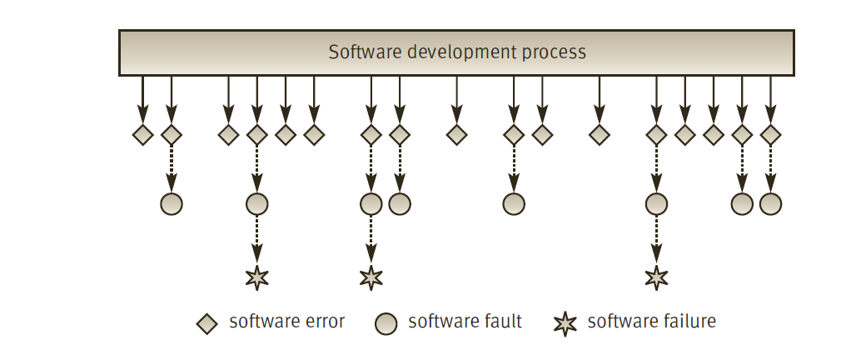
The Relationships between Software errors, faults and failures

Slide 10
Software errors, faults and failures
Software errors are sections of the code that are partially or totally incorrect as a result of a grammatical, logical or other mistake. ( made by a systems analyst, a programmer, or another member of the software development team) → made by human
Software faults are software errors that cause the incorrect functioning of the software during a specific application.
Software faults become software failures only when they are “activated”, that is, when a user tries to apply the specific software section that is faulty.
Thus, the root of any software failure is a software error.
Notes:
Contoh kesalahan logika menterjemahkan rumus, menyebabkan hasil yang salah atau divide by zero, menyebabkan kesalahan perhitungan yg jika digunakan akan fatal
Pada Ms Excel 2007, dihitung 850x77,1 hasilnya seharusnya 65536 namun yang ditampilkan 100000

Slide 11
Identify the various causes of software errors
Coding errors
Logical design errors
Faulty requirements definition
Client–developer communication failures
Deliberate deviations from software requirements
Non-compliance with documentation and coding instructions
Shortcomings of the testing process
Procedure errors
Documentation errors
It should be emphasized that all causes of error are human, the work of systems analysts, programmers, software testers, documentation experts, and even clients and their representatives.

Slide 12
Faulty requirements definition
Erroneous definition of requirements.
Absence of vital requirements.
Incomplete definition of requirements.
Inclusion of unnecessary requirements, functions that are not expected to be needed in the near future.

Slide 13
Client–developer communication failures
Misunderstanding of the client’s instructions as stated in the requirement document.
Misunderstanding of the client’s requirements changes presented to the developer in written form during the development period.
Misunderstanding of the client’s requirements changes presented orally to the developer during the development period.
Misunderstanding of the client’s responses to the design problems presented by the developer.
Lack of attention to client messages referring to requirements changes and to client responses to questions raised by the developer on the part of the developer.

Slide 14
Deliberate deviations from software requirements
The developer reuses software modules taken from an earlier project without sufficient analysis of the changes and adaptations needed to correctly fulfill all the new requirements.
Due to time or budget pressures, the developer decides to omit part of the required functions in an attempt to cope with these pressures.
Developer-initiated, unapproved improvements to the software, introduced without the client’s approval, frequently disregard requirements that seem minor to the developer. Such “minor” changes may, eventually, cause software errors.

Slide 15
Logical design errors
Definitions that represent software requirements by means of erroneous algorithms.
Process definitions that contain sequencing errors.
Erroneous definition of boundary conditions.
Omission of required software system states.
Omission of definitions concerning reactions to illegal operation of the software system.

Slide 16
Coding Errors
A broad range of reasons cause programmers to make coding errors.
These include misunderstanding the design documentation, linguistic errors in the programming languages, errors in the application of CASE and other development tools, errors in data selection, and so forth.

Slide 17
Non-compliance with documentation and coding instructions
Team members who need to coordinate their own codes with code modules developed by “non-complying” team members can be expected to encounter more than the usual number of difficulties when trying to understand the software developed by the other team members.
Individuals replacing the “non-complying” team member (who has retired or been promoted) will find it difficult to fully understand his or her work.
The design review team will find it more difficult to review a design prepared by a non-complying team.
The test team will find it more difficult to test the module; consequently, their efficiency is expected to be lower, leaving more errors undetected.
Maintenance teams required to contend with the “bugs” detected by users and to change or add to the existing software will face difficulties when trying to understand the software and its documentation.

Slide 18
Shortcomings of the testing process
Incomplete test plans leave untreated portions of the software or the application functions and states of the system.
Failures to document and report detected errors and faults.
Failure to promptly correct detected software faults as a result of inappropriate indications of the reasons for the fault.
Incomplete correction of detected errors due to negligence or time pressures.

Slide 19
Procedure errors
Procedures direct the user with respect to the activities required at each step of the process.
They are of special importance in complex software systems where the processing is conducted in several steps, each of which may feed a variety of types of data and allow for examination of the intermediate results.

Slide 20
Documentation Errors
Omission of software functions.
Errors in the explanations and instructions given to users, resulting in “dead ends” or incorrect applications.
Listing of non-existing software functions, that is, functions planned in the early stages of development but later dropped, and functions that were active in previous versions of the software but cancelled in the current version.

Slide 21
Software Quality Assurance
Software quality assurance – The IEEE definition
A planned and systematic pattern of all actions necessary to provide adequate confidence that a product conforms to established technical requirements.
A set of activities designed to evaluate the process by which the products are developed or manufactured.

Slide 22
The characteristic of IEEE Definition
Plan and implement systematically.
SQA is based on planning and the application of a variety of actions that are integrated into all the stages of the software development process. This is done in order to substantiate the client’s confidence that the software product will meet all the technical requirements.
Refer to the software development process.
Refer to the specifications of the technical requirements.

Slide 23
SQA – expanded definition
Software quality assurance is:
A systematic, planned set of actions necessary to provide adequate confidence that the software development process or the maintenance process of a software system product conforms to established functional technical requirements as well as with the managerial requirements of keeping the schedule and operating within the budgetary confines.
(ISO 9000 standards regarding SQA, the Capacity Maturity Model (CMM) for software (Paulk et al., 1993; Tingey, 1997).

Slide 24
The main deviations from the IEEE definition
SQA should not be limited to the development process.
SQA actions should not be limited to the technical aspects of the functional requirements, but should include also activities that deal with scheduling and the budget.

Slide 25
The Relationship between Software Quality Assurance and Software Engineering
Software engineering is the application of a systematic, disciplined, quantifiable approach to the development, operation and maintenance of software.
The characteristics of software engineering, especially its systematic, disciplined and quantitative approach, make software engineering a good environment for achieving SQA objectives.
It is commonly accepted that cooperation between software engineers and the SQA team is the way to achieve efficient and economic development and maintenance activities that, at the same time, assure the quality of the products of these activities.

Slide 26
The objectives of SQA activities
Software development (process-oriented):
Assuring an acceptable level of confidence that the software will conform to functional technical requirements.
Assuring an acceptable level of confidence that the software will conform to managerial scheduling and budgetary requirements.
Initiating and managing of activities for the improvement and greater efficiency of software development and SQA activities.

Slide 27
The objectives of SQA activities
Software maintenance (product-oriented):
Assuring with an acceptable level of confidence that the software maintenance activities will conform to the functional technical requirements.
Assuring with an acceptable level of confidence that the software maintenance activities will conform to managerial scheduling and budgetary requirements.
Initiating and managing activities to improve and increase the efficiency of software maintenance and SQA activities.

Slide 28
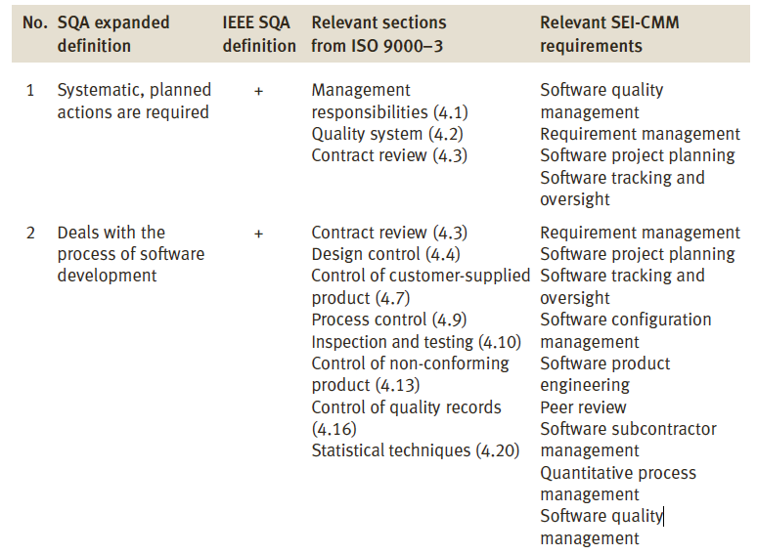
The expanded SQA definition-comparisons with other versions

Slide 29
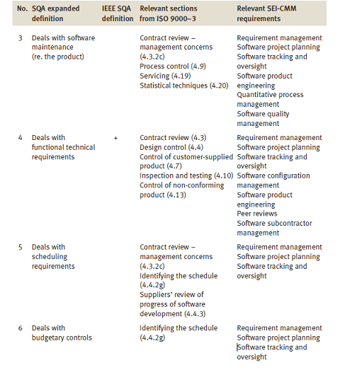
The expanded SQA definition-comparisons with other versions (Cont)

